Slide 1

Prepared by group 7
Group Project
Car Rental Service
13th November, 2024

Slide 2
Team Members
Ayush Arya
Priyanshu
Anjali Chauhan
Pavani Arra

Slide 3
Introduction
This Car Rental Service project is a full-stack web application designed to streamline car rental management. It consists of:
Backend (Spring Boot - Java): The backend, developed with Spring Boot, handles core functionalities such as authentication (using JWT for secure access), user and admin management, car bookings, and data interactions. It includes various controllers, DTOs (Data Transfer Objects), repositories, and configuration files, making it a structured, scalable, and secure service.
2. Frontend (Angular): The frontend, built with Angular, provides an interactive user interface. Key components include a login page, an admin dashboard, and booking pages. The frontend communicates with the backend via services, managing authentication and user interactions seamlessly.
Overall, this project is a comprehensive solution for managing car rentals, designed with security, modularity, and a smooth user experience in mind.

Slide 4
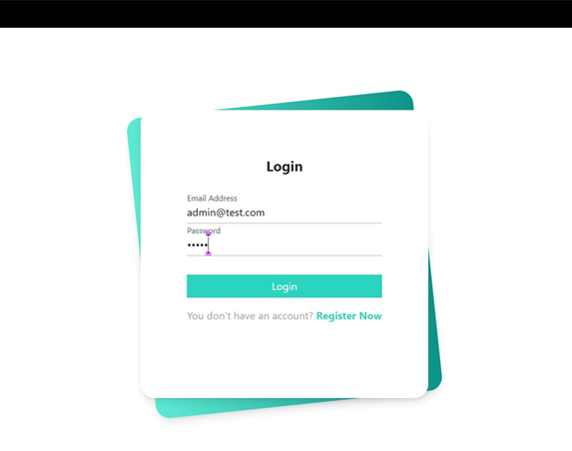
Project Goals & Objectives
Goals:
Provide a seamless car rental experience.
Offer secure user authentication and data protection.
Enable efficient car and booking management for admins.
Objectives:
Enhance user satisfaction.
Build a scalable platform.
Streamline rental operations.

Slide 5

Technology Stack
Forntend:
Used zorro library in Angular for building an interactive and responsive UI.
Database:
MySQL for database storage.
Backend:
Spring Boot for handling business logic and APIs.

Slide 6



Key Functionalities
User Features
Admin Features
Register
login
browse/search cars
book rentals.
Manage car inventory
handle bookings.
Security Features
JWT authentication and role-based access control.

Slide 7


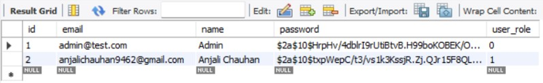
Database Schema
bookacar:
cars:
users:

Slide 8

Methodology
Requirements Gathering and Analysis:
Understand the project's goals, define essential features, and identify user needs.
Prepare a functional and non-functional requirements specification document to guide development.
System Design:
Architect the project for efficient data flow, component interaction, and maintainability.
Design an Architecture Diagram with Angular as the frontend and Spring Boot as the backend and Creating the database schema.
Testing and Deployment:
Verify the interaction between components and ensure the system functions as a whole.
Deploy the application to a production environment, making it accessible to users.

Slide 9
Demo Video

Slide 10
Future Enhancement
Future enhancements for the car rental service project could include advanced search and filtering, real-time car availability, and dynamic pricing with discounts. A mobile app could enhance accessibility with geolocation for car pick-up/drop-off and push notifications. Security features like multi-factor authentication, GPS tracking, and multiple payment gateways would improve reliability and ease of use. An enhanced admin dashboard could provide insights and streamline inventory management. Additional features like user feedback, vehicle maintenance tracking, multilingual support, and insurance options would improve the user experience and make the platform more robust and user-friendly.

Slide 11
Conclusion
the car rental service project provides a strong foundation for managing rentals, customer interactions, and administrative tasks. With potential future enhancements such as advanced search options, dynamic pricing, mobile app support, and additional security and payment features, the platform can become even more user-centric and efficient. These improvements would not only enhance the user experience but also increase operational flexibility, making the service adaptable to various market needs and better positioned for growth.

Slide 12
Thank you

